Slide 1
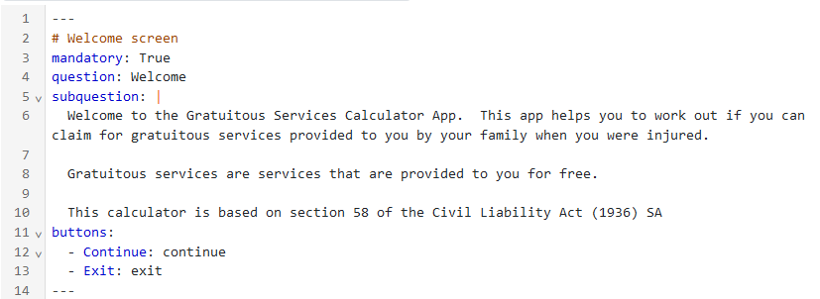
Each block starts and finishes with three dashes.
This is a comment. It isn’t processed as code and describes the block.
Comments are good ☺
There must be one space here
These ‘tags’ are always aligned against the left margin
Text inside a subquestion must be indented by two spaces.
Line numbers show which line you’re on
There must be two spaces here
There must be one space here
There must be one space here

Slide 2
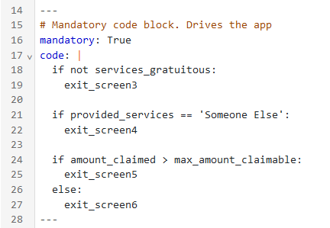
These ‘tags’ are always aligned against the left margin
If statement must finish with a colon
This is the ‘true branch’. It must be indented at least two spaces right of the ‘if’
All code in a code block must be indented at least 2 spaces from the margin
These blank lines are optional. They make the code more readable
True branch
‘else’ must finish with a colon
True/false branches must be indented exactly 2 spaces in from ‘if’ or ‘else’
False branch

Slide 3
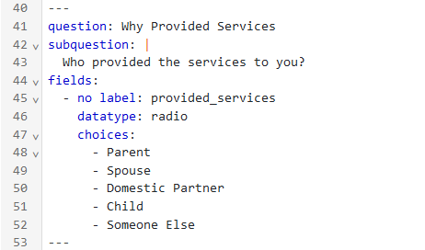
There must be one space here
There must be two spaces here
This is the ‘field label’ It appears on your program’s screen. In this case we’ve specified for no label at all to be displayed.
These must be aligned with the field label (‘no label’ in this case)
The dashes must be aligned two spaces in from ‘choices’
There must be one space between the dash and the data

